Slide 1


Securing your Angular app with Azure Active Directory

Slide 2

Sam Striano
Who’s Sam?
Senior Technical Lead @ Axian
sstriano@axian.com
GitHub: https://github.com/axiansam
TITLE

Slide 3

AGENDA
Create and configure an Azure Active Directory
In this step we will create an Application Registration, configure permissions, oAuth flows and callback endpoints.
Create and configure an Angular application
Using the CLI we will create a new Angular application and configure the basics to get it up and running.
Wire-up Azure AD to the Angular application
In this step, we will use MSAL to wire up the Azure AD Application to the Angular application to perform authentication and to authorize the Angular app to use the Microsoft Graph API to obtain the logged in users profile data.

Slide 4
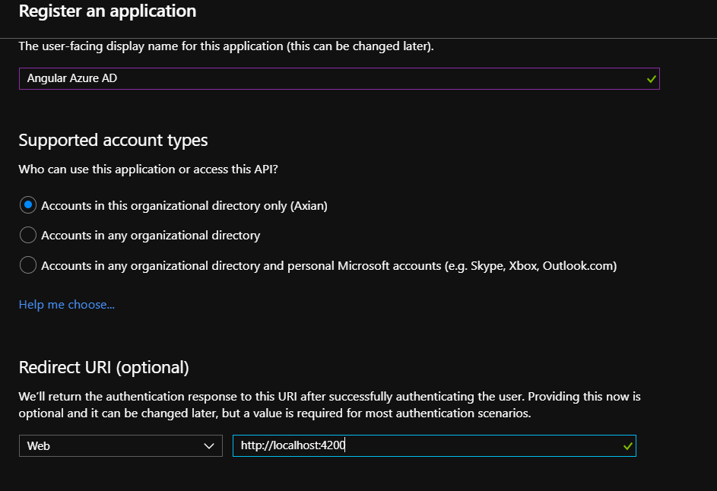
Register Application in Azure AD

Slide 5
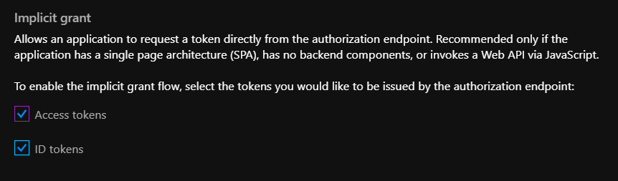
Enable Implicit Grant
Enable Implicit Grant flow to issue Access and ID tokens

Slide 6
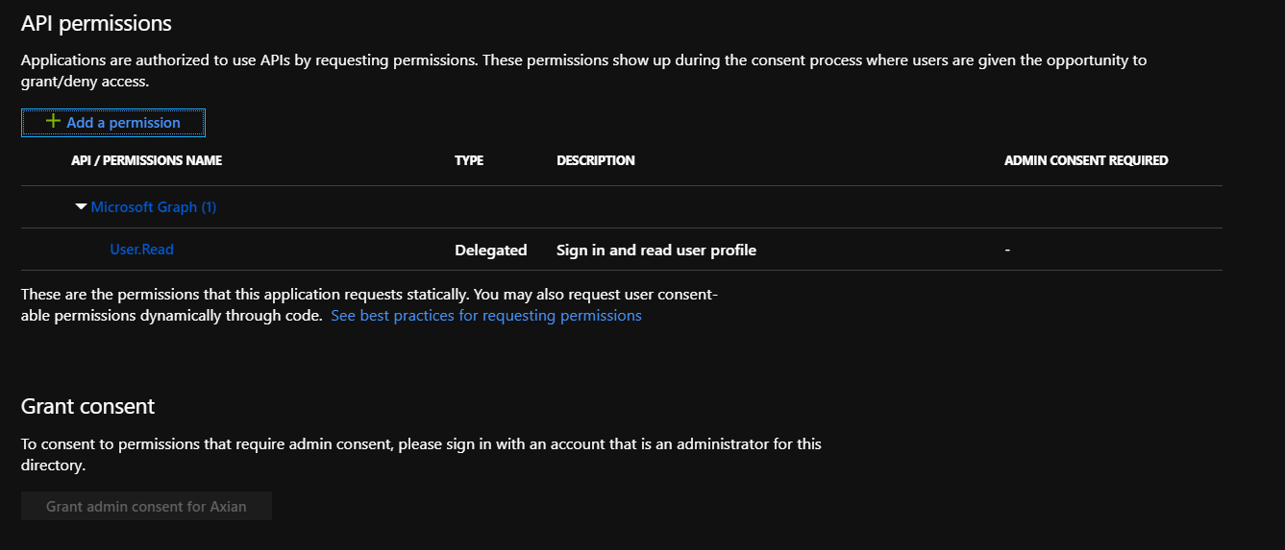
Verify Permissions/Grant Consent
Verify permissions to Microsoft Graph
Grant admin consent for the directory to the application

Slide 7
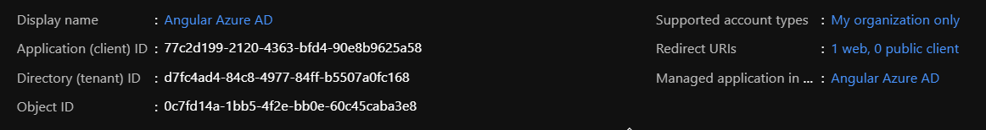
Application Dashboard
Copy Application (Client) ID
Copy Directory (Tenant) ID

Slide 8
Create Angular application with CLI
Open Powershell/Command prompt
ng new azuread --routing --style=scss
npm install will restore packages
Add the @azure/msal-angular package
Add the rxjs-compat package
Run npm install once more
Run ng serve and verify we have a working app @ http://localhost:4200

Slide 9
Configure MSAL
Configure MSAL Module in the app.module
MsalModule.forRoot({
authority: 'https://login.microsoftonline.com/<TenantId>’,
clientID: '<ClientId>’,
protectedResourceMap: [
['https://graph.microsoft.com', ['user.read’]]
],
redirectUri: window.location.origin + '/'
})

Slide 10
Configure MSAL
Configure MsalInterceptor in app.module providers
Import HttpClientModule
providers: [
{
provide: HTTP_INTERCEPTORS,
useClass: MsalInterceptor,
multi: true
}
],

Slide 11
Generate new Component
Generate a new component by running the ‘ng g component home’ command from the command line.
We will setup the routing to this component as the default route

Slide 12
Configure App Component/Routing
Replace the contents of the app.component.html to just have a <router-outlet></router-outlet>
Create the following routes in the app-routing.module using the MsalGuard to protect access to the route
const routes: Routes = [
{ path: '', redirectTo: 'home', pathMatch: 'full' },
{ path: 'home', component: HomeComponent, canActivate: [MsalGuard] }
];

Slide 13
Use MsalService to access user profile
Configure home.component to use the MsalService to access the logged in users profile information.
Inject the MsalService into the constructor
In the ngOnInit() get the user from the MsalService
constructor(private msalService: MsalService) { }
ngOnInit() {
this.user = this.msalService.getUser();
}

Slide 14

Questions?

